Slide 1







Data Science Ethics
Mark Nielsen
2018 Big Mountain Data & Dev
nielsenmark.us | github.com/nielsenmarkus11/ds-ethics
Notes:
Creating ML and AI models has gotten easier and easier. It is no longer difficult to produce predictive models for varying disciplines. We are responsible to ensure ML and AI methods are properly applied to real life scenarios.

Slide 2







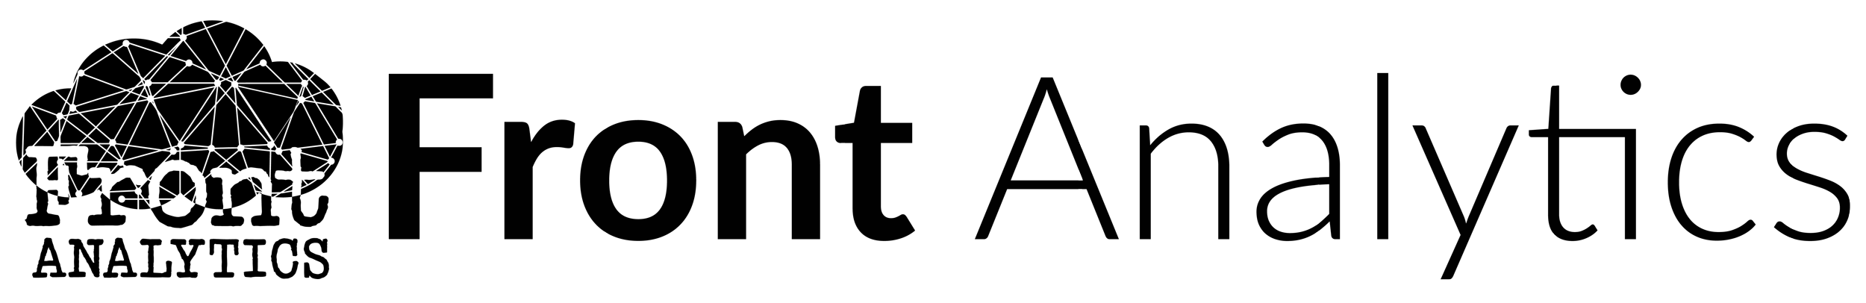



Thanks to our Sponsors!
Partners
Premier
Logo:

Slide 3
Lab Hazards that can Catch You Unawares!
Too much value put on p-values, accuracy, AUC.
Overfitting and mis-application of model
Releasing preliminary results (your project grows legs)
Publication bias
It’s all just numbers…
Notes:
This should be a list of problems and examples. ( beauty.ai, tay.ai, etc. )

Slide 4
1st Lab Hazard
Problem: Too much weight is put on p-values, accuracy, AUC, etc. and in extreme cases “p-value engineering.”

Slide 5
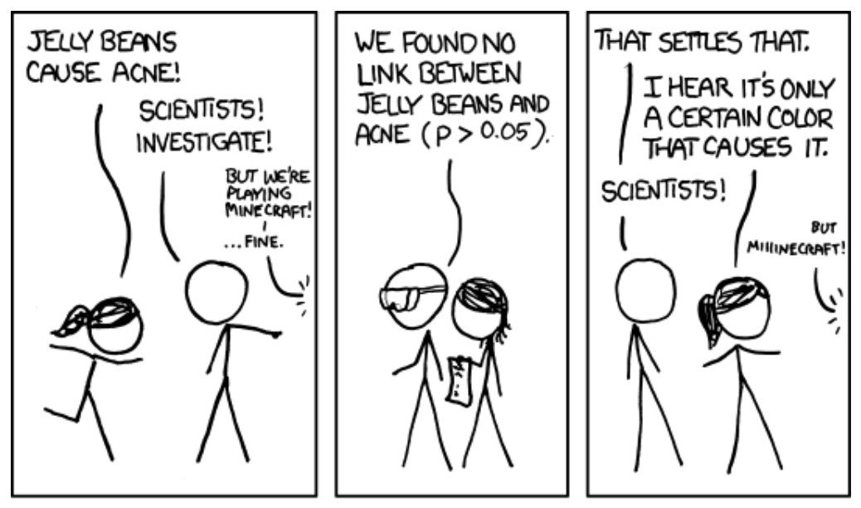
Significant – by xkcd

Slide 6
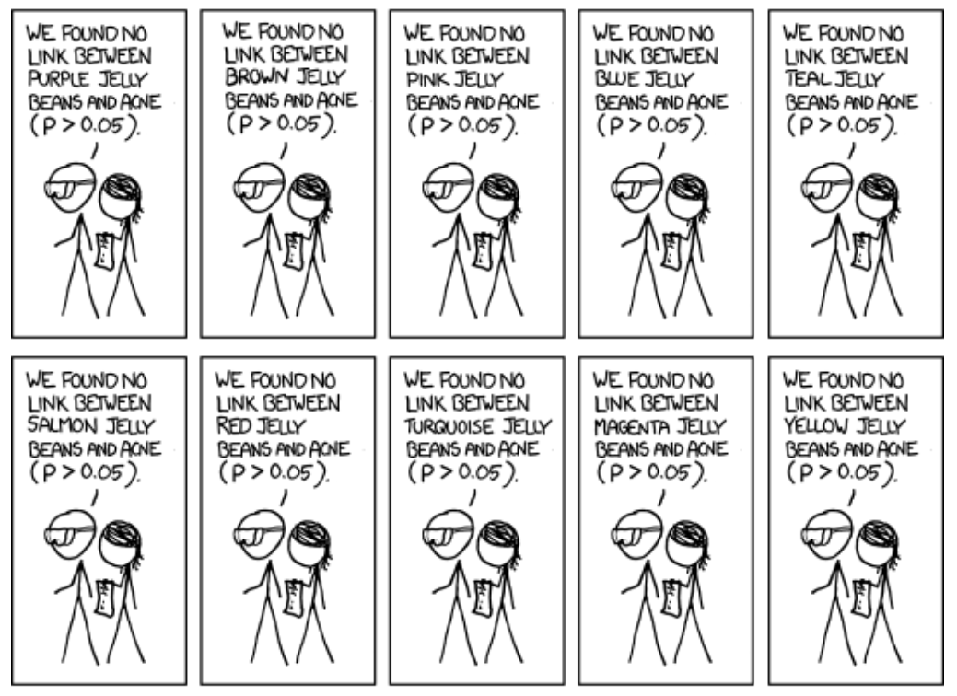

Slide 7
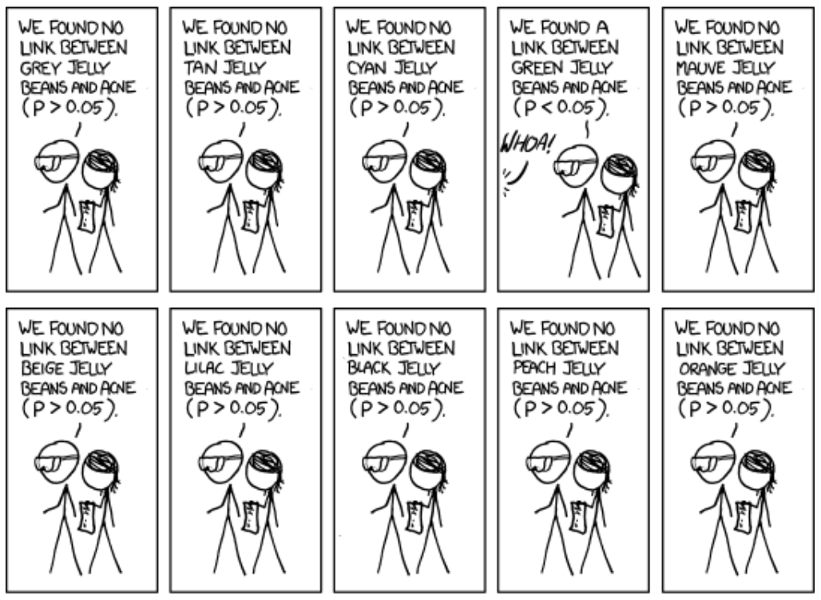

Slide 8
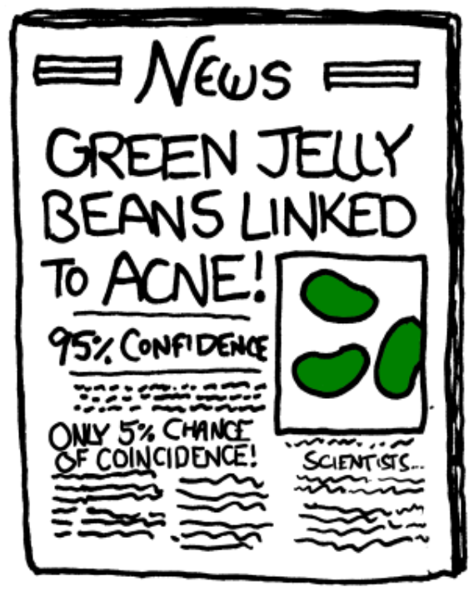
Notes:
Does this happen in real life? You don’t think this happens?
***I had a student that I tutored who previously worked for an oil company. If he came back with insignificant results he was told to go back and test again.

Slide 9
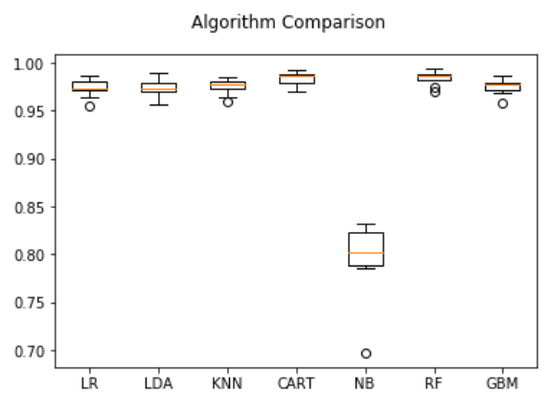
Another Example… Accuracy
How accurately can we predict a “gas guzzler?”
Could get 94% Accuracy if we just classify no cars as “gas guzzlers.”
Notes:
This is a model about gas guzzlers I put together to show a tutorial on using scikit-learn.
This has happened to me several times in my career. It’s funny when you look at Pseudo R-squared you typically get a negative value for this type of model.
This would be a clear indication of something going wrong.

Slide 10
Another Example…AUC
Performance Measure | Disease 1 | Disease 2 | Disease 3
Original AUC | 0.90 | 0.86 | 0.87
Notes:
These numbers are definitely “publishable” to some standards.

Slide 11
Another Example…AUC
Performance Measure | Disease 1 | Disease 2 | Disease 3
Original AUC | 0.90 | 0.86 | 0.87
Accuracy | 99.5% | 99.9% | 98.9%
Notes:
Let’s look at another measure… accuracy. Hey these are looking even better!
Now, we loved the results, so we decided to implement and send the patients we’ve predicted to be most likely to develop these conditions to some care managers.
But before sending we wanted to make sure we knew how many of the patients we sent would likely end up developing these conditions…

Slide 12
Another Example…AUC
Performance Measure | Disease 1 | Disease 2 | Disease 3
Original AUC | 0.90 | 0.86 | 0.87
Accuracy | 99.5% | 99.9% | 98.9%
Positive Predictive Value | 13.4% | 4.0% | 15.6%
Notes:
Whoa! What happened? Only 4-15% of the names we would have sent didn’t result in the disease?
They may loose trust in the work I do for them if I were to send this over as is.
Anyone have an idea why this could be?

Slide 13
Another Example…AUC
Performance Measure | Disease 1 | Disease 2 | Disease 3
Original AUC | 0.90 | 0.86 | 0.87
Accuracy | 99.5% | 99.9% | 98.9%
Positive Predictive Value | 13.4% | 4.0% | 15.6%
Proportion of Data with Disease | 0.3% | 0.1% | 0.7%
Notes:
The proportions of those that have the disease compared to those that don’t is very small. Don’t be deceived.
In fact, in every case above, I would be better off to just predict that no one has any disease and I’d get better accuracy.

Slide 14
1st Lab Hazard
Problem: Too much weight is put on p-values, accuracy, AUC, etc. and in extreme cases “p-value engineering.”
Solution: Understand and look at multiple measures.

Slide 15
2nd Lab Hazard
Problem: Overfitting, data bias, and/or mis-application of predictive model.

Slide 16
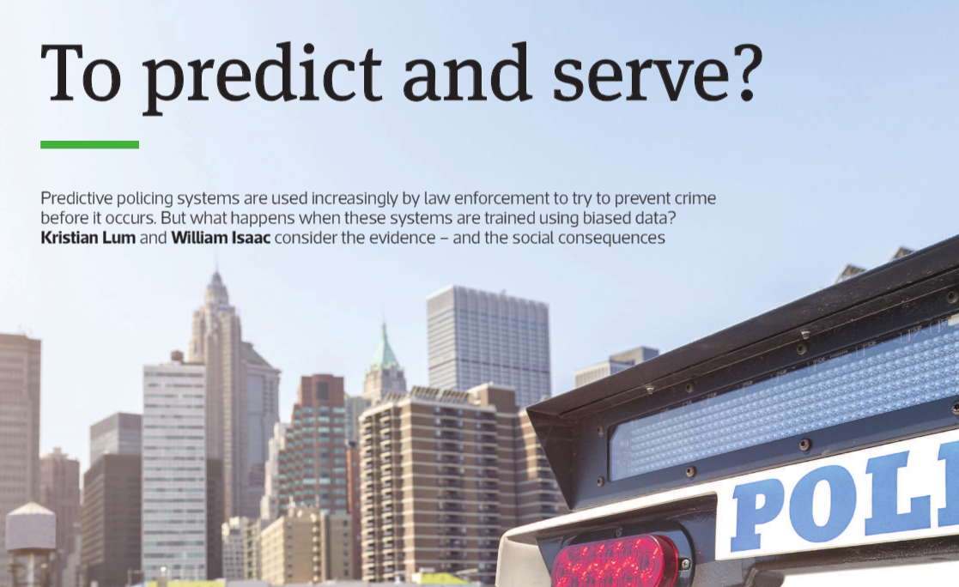
Notes:
PredPol ML tool to help policing efforts touts their algorithm as a parsimonious race-neutral system that uses “only three data points in making predictions: past type of crime, place of crime, and time of crime. It uses no personal information about individuals or groups of individuals, eliminating any personal liberties and profiling concerns.”

Slide 17
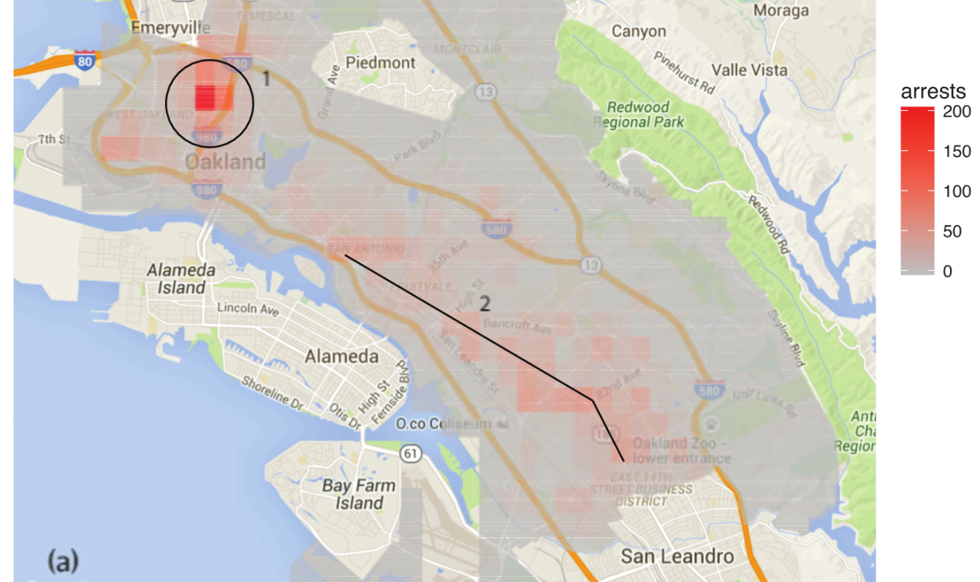
Oakland PD Data
Notes:
This is a distribution of the number of drug arrests in 2010 based on data from Oakland Police Department.
This will likely be used to determine individuals risk of committing a drug offense or help determine where the police officers should do their beat.
CONFIRMATION BIAS

Slide 18
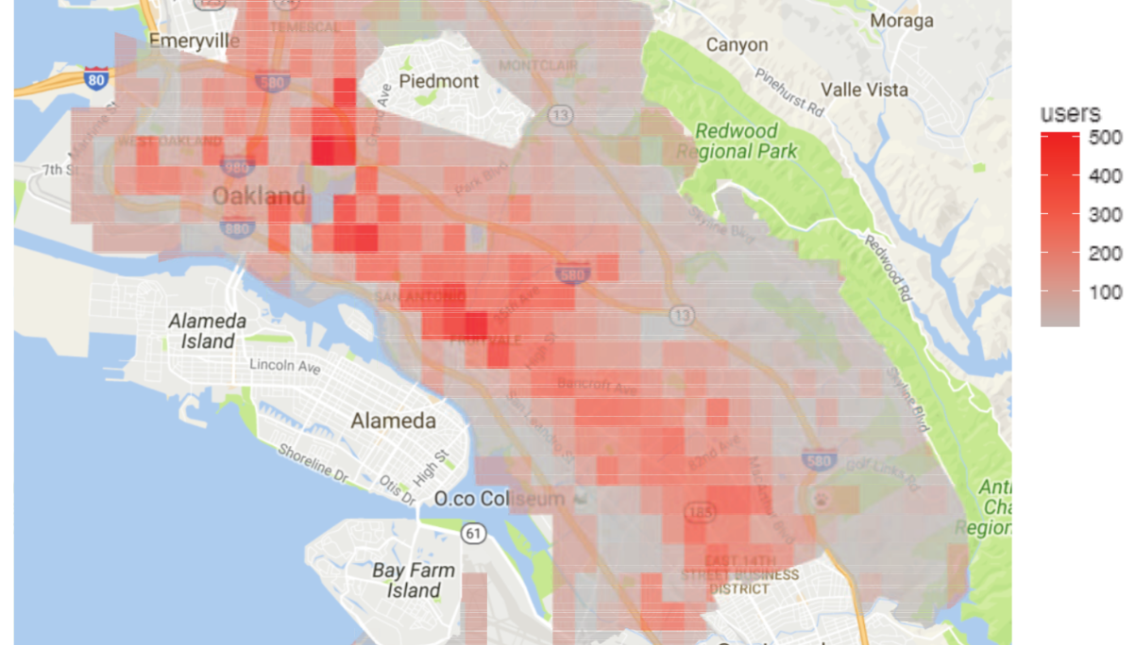
NSDUH Data
Notes:
In contrast, Estimated number of drug users, based on 2011 National Survey on Drug Use and Health.
Apparently, there appears to be a disproportionate focus on West Oakland instead of International Boulevard.

Slide 19
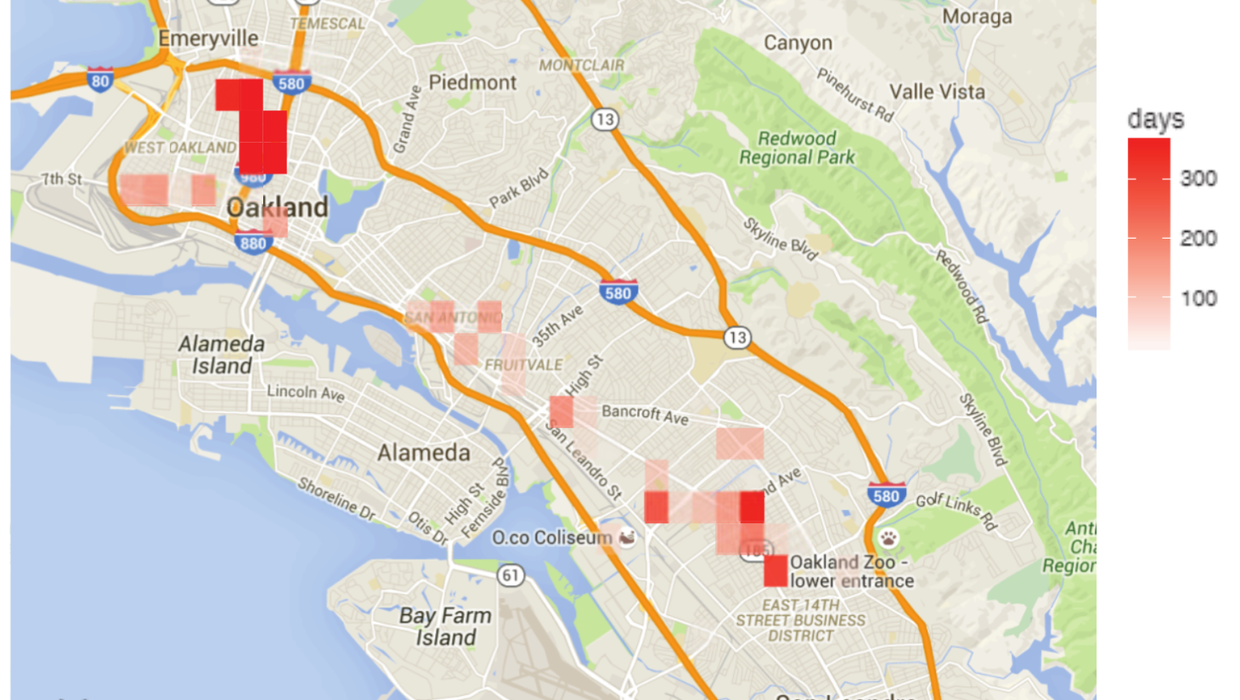
PredPol Algorithm
Notes:
Rather than correcting the biases in the police data it only reinforces them.

Slide 20
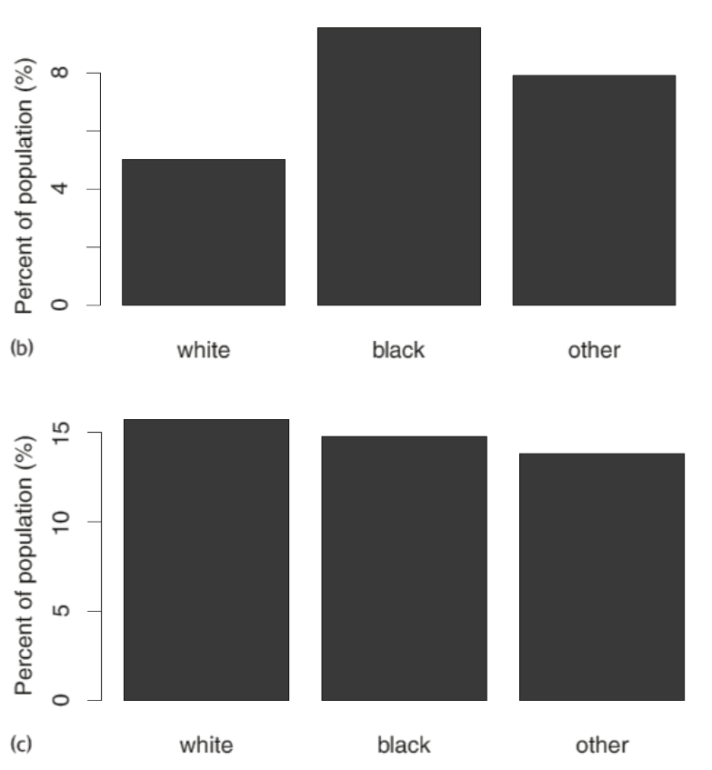
What about the claim that the algorithm “eliminates any… profiling concerns?”
Targeted Policing for
Drug Crimes
Estimated Drug Use by Race
(NSDUH)
Notes:
What about the “race-neutral” feature of the algorithm?
Just because we don’t include race in the model doesn’t mean there is no bias in the data.

Slide 21
2nd Lab Hazard
Problem: Overfitting, data bias, and/or mis-application of predictive model.
Solution: Validation. Use out-of-sample or out-of-time validations and validate with external data if possible.

Slide 22
3rd Lab Hazard
Problem: Releasing preliminary results or pushing to productionalize a Minimally Viable Product (MVP) causing your project to “grow legs.”

Slide 23

Notes:
The Assumptions of Technological Manifest Destiny
Technology is VALUE-NEUTRAL, and will therefore automatically lead to good outcomes for everyone.
Thus, new kinds of technology should be deployed as quickly as possible, even if we lack a general idea of how the technology works, or what the societal impact will be.
History is generally uninteresting, because the past has nothing to teach us.

Slide 24
3rd Lab Hazard
Problem: Releasing preliminary results or pushing to productionalize a Minimally Viable Product (MVP) causing your project to “grow legs.”
Solution: Never productionalize an MVP and have clear review procedures in place.

Slide 25
4th Lab Hazard
Problem: A large portion of published studies rely too heavily on p-values which results in publication bias.
Notes:
This may not be as common among practicing data scientists and statisticians, and there has been some increased awareness of this issue.

Slide 26
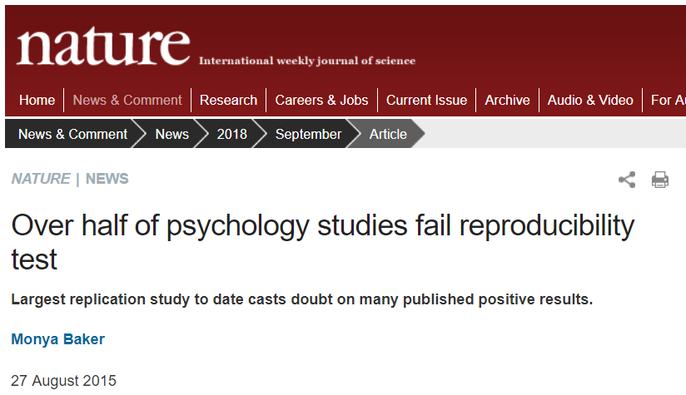
Notes:
This article heading best articulates the problem… and yes psychology articles more often than not are going to be based off of small sample sizes.
Be sure to note that too much data can also be a problem. (Share example below)
I’ve had former customers say when reporting confidence intervals, I don’t care how different they are… are they significant or not?

Slide 27
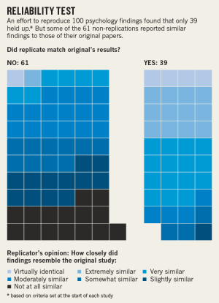
Lab Safety is Becoming a Priority
Basic and Applied Social Psychology bans p-values from publications:
“P values … were too often used to support lower quality research.”
ASA makes statement on the use of p-values:
“Scientific conclusions and business or policy decisions should not be based only on whether a p-value passes a specific threshold.”
Notes:
Does this happen? YES!
Share experience of wife’s professor who asked her to re-write her hypothesis with supporting articles to match the result of her logistic regression model.

Slide 28
4th Lab Hazard
Problem: A large portion of published studies rely too heavily on p-values which results in publication bias.
Solution: Follow proper publication procedures and ethics. “Pre-registration” of research articles has potential.

Slide 29


5th Lab Hazard
Problem: It’s just a bunch of numbers…

Slide 30
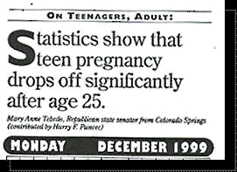
Notes:
I hope that it drops off completely after 19 ☺
We should always review our own work and ask ourselves: “What story does this analysis tell me?”

Slide 31
5th Lab Hazard
Problem: It’s just a bunch of numbers…
Solution: Know your data!
Notes:
Trust your gut… you know your data best and when you get unexpected results double and triple check it again as if you did something wrong.
Share introductory offer story from credit card analysis. The data was not randomized properly.

Slide 32
Lab Safety Begins Before You Go to the Lab!
Too much value put on p-values, accuracy, AUC.
Overfitting and mis-application of model
Releasing preliminary results (your project grows legs)
Publication bias
It’s all just numbers…
Notes:
Don’t fall victim to preventable disasters in the Data Science Lab.

Slide 33
Lab Safety Begins Before You Go to the Lab!
Too much value put on p-values, accuracy, AUC.
Overfitting and mis-application of model
Releasing preliminary results (your project grows legs)
Publication bias
It’s all just numbers…
Notes:
Instead prepare yourself with the right protections to be a successful data scientist.

Slide 34
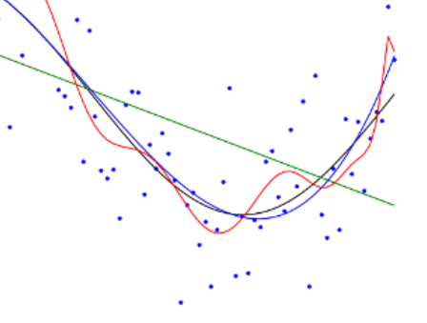





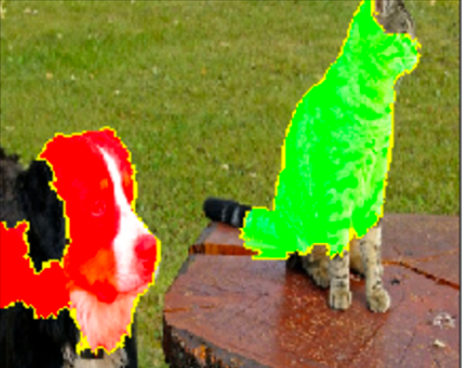

Dressing for Lab
x=1;
while (x>0) {
message = “Hi”;
print message;
};
Understand bias and variance
Validation
Sufficient Review
Understand the Model and Data
“Gut” Check
Replicable Results
Notes:
Instead prepare yourself with the right protections to be a successful data scientist.
Review: not only code review but content and result review as well.
The dog/cat image is from the LIME package, which can help you understand your black-box models.
Go with your gut feeling. You’ll often be right.

Slide 35
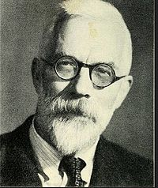
No one is immune…
“It is possible, then, that lung cancer… is one of the causes of smoking cigarettes? I don’t think it can be excluded.” –RA Fisher
His views may have been influenced by his employment as a consultant in the tobacco industry or the fact that he himself was a smoker.
Notes:
As a final reminder, we know that no one is immune to personal or professional bias themselves. We need to be as objective as possible.
Make efforts to understand your own personal and professional biases.
To quote his biographers Yates and Mather, "It has been suggested that the fact that Fisher was employed as consultant by the tobacco firms in this controversy casts doubt on the value of his arguments. This is to misjudge the man. He was not above accepting financial reward for his labours, but the reason for his interest was undoubtedly his dislike and mistrust of puritanical tendencies of all kinds; and perhaps also the personal solace he had always found in tobacco.“

Slide 36
Sources:
1. Fisher, R. (1958). CIGARETTES, CANCER, AND STATISTICS. The Centennial Review of Arts & Science, 2, 151-166. Retrieved from http://www.jstor.org/stable/23737529
2. Yates, F. & Mather, K. (1963). "Ronald Aylmer Fisher 1890–1962". Biographical Memoirs of Fellows of the Royal Society. 9: 91–129. doi:10.1098/rsbm.1963.0006.
3. Munroe, R. Significant. Retrieved from https://xkcd.com/882
4. Lum, K. & Isaac, W. (2016). To predict and serve?. Significance, 13(5), pp. 14-19.
5. Baker, M. (2015). Over half of psychology studies fail reproducibility test. Nature. Retrieved from http://www.nature.com/news/over-half-of-psychology-studies-fail-reproducibility-test-1.18248
6. Ronald Fisher. (n.d.). In Wikipedia. Retrieved October 7, 2018, from https://en.wikipedia.org/wiki/Ronald_Fisher
7. Mickens, James. “Q: Why Do Keynote Speakers Keep Suggesting That Improving Security Is Possible?” YouTube, USENIX, 16 Aug. 2018, www.youtube.com/watch?v=ajGX7odA87k
8. Ronald L. Wasserstein & Nicole A. Lazar (2016) The ASA's Statement on p-Values: Context, Process, and Purpose, The American Statistician, 70:2, 129-133, DOI: 10.1080/00031305.2016.1154108
9. Woolsten, C. (2015). Psychology Journal Bans P Values. Nature. Retrieved from https://www.nature.com/news/psychology-journal-bans-p-values-1.17001#/b1
10. Godfrey, A. (2011, September). Teen Pregnancy Drops Off After Age 25, Other Funny Newspaper Clippings. Retrieved from https://nostalgia049.wordpress.com/2011/09/27/teen-pregnancy-drops-off-after-age-25-other-funny-newspaper-clippings/
11. Gray, M. W. (2016). Just Say No! [pptx]. Retrieved from https://ww2.amstat.org/meetings/csp/2016/onlineprogram/AbstractDetails.cfm?AbstractID=303159

Slide 37
Thanks to our Sponsors!
Partners
Premier
Logo:
Notes:
Thank you for coming and remember to thank our sponsors!

Slide 38
Remember… Safety First!
Questions? …Comments?
2018 Big Mountain Data & Dev
nielsenmark.us | github.com/nielsenmarkus11/ds-ethics
Notes:
Questions? Comments?
Please fill out a feedback form!

